Slide 1
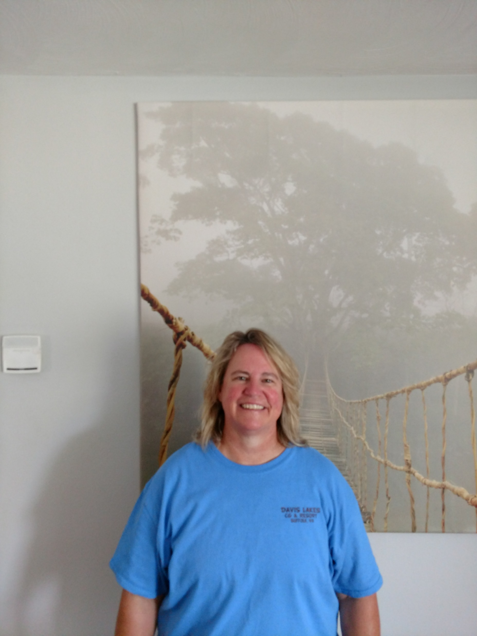

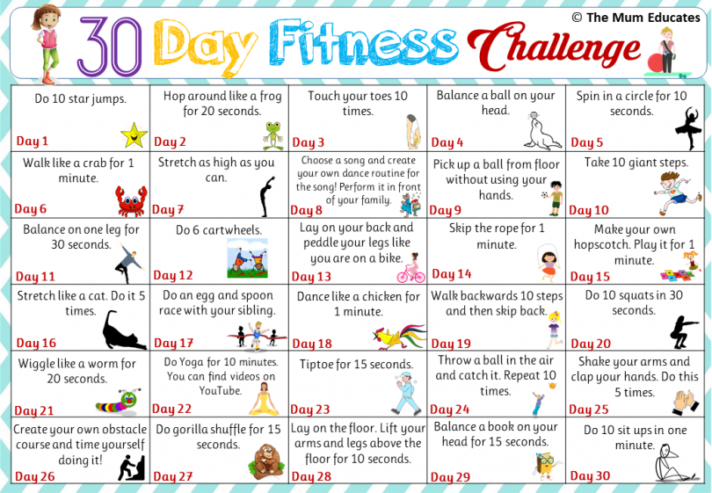
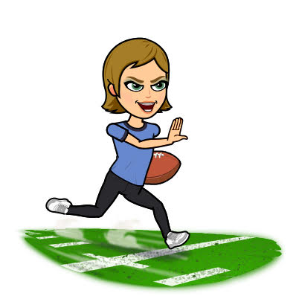
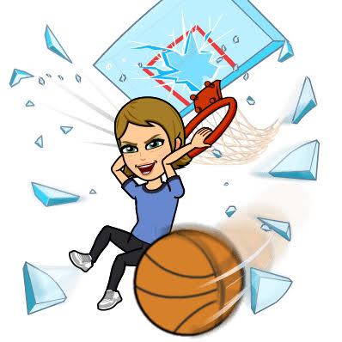
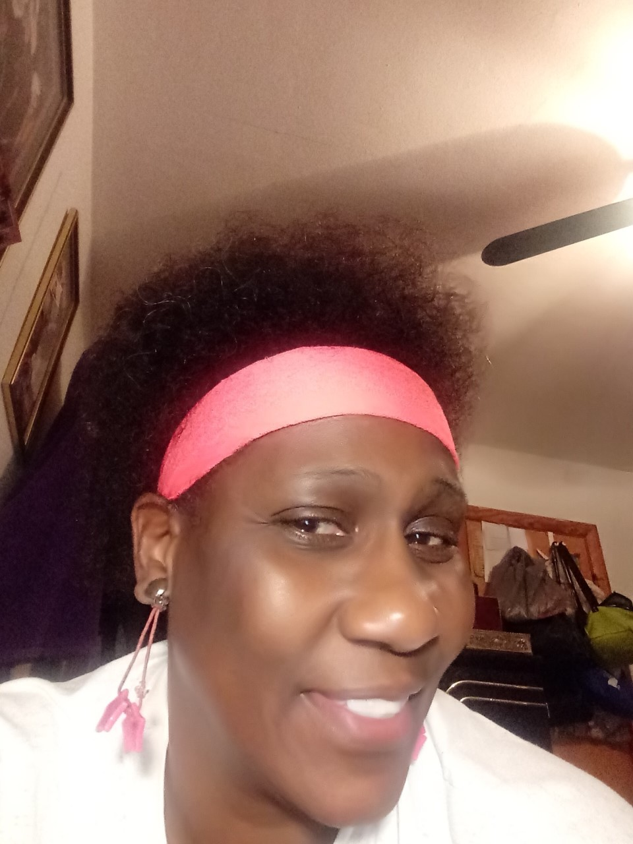
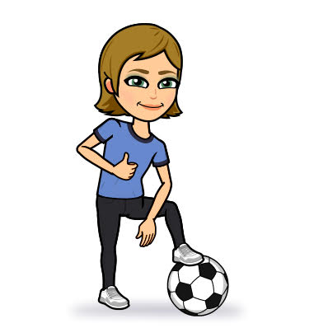
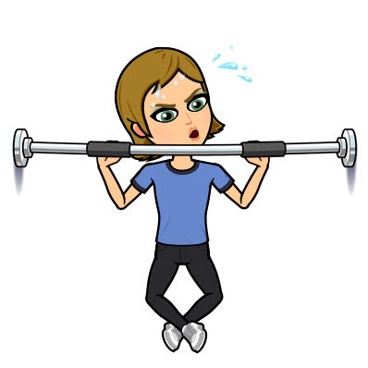
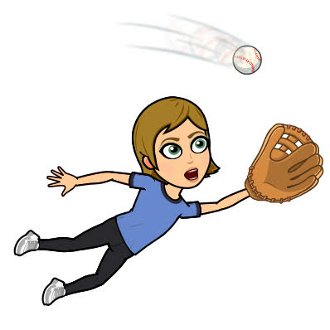
Welcome Willard Sharks to the 2021-2022 School Year!!
Education
Physical education is a course taught to focus on developing physical fitness. Effective P.E. classes help students develop skill and confidence, maintain physical fitness, learn about personal health and wellness, and demonstrate positive social skills.
Click Here:
Your PE Teachers:
Ms. Gulden and
Ms.Austin

